Slide 1
Analytics Project Presentation - Fall 2015
Analytics Project: Best Places To Live In The United States
Team: Prachee Mhatre, Shruti Goel, Sreerupa Nandi
Abstract: This research work is based on finding the most livable cities in the United States with respect to certain livability criteria namely, public safety, environment-friendliness, economy, healthcare infrastructure, climatic conditions, housing conditions, educational infrastructure and transport system. We have also extended our study by assigning weights to the above mentioned criteria in order to refine the results.

Slide 2
Best Places To Live In The United States
Motivation
Who are the users of this analytic? Anyone planning to reside in the United States
Who will benefit from this analytic? Anyone planning to move to any city within the United States
Why is this analytic important? With our analytics based on several deciding factors, it will be easier for common men with little or no knowledge of the livability conditions of cities hundreds of miles away, to plan their next move
What steps were taken to assess the ‘goodness’ of the analytic?
The analytics is based on actual rates across the 100 most populated cities and user discretion of livability criteria which increases the dynamicity of the results.

Slide 3
Best Places To Live In The United States
Data Sources
Name: Crime rates
Description: This data describes the crime rates in US cities
Size of data: 800MB
Source: FBI Crime Statistics
Name: Unemployment rates
Description: This data describes the unemployment rates across US cities
Size of data: 500MB
Source: Bureau of Labor Statistics
Name: Air Quality
Description: This data describes the air quality, particularly the concentration of SO2, PM2.5, PM10
Size of data: 2GB
Source: United States Environmental Protection Agency

Slide 4
Design Diagram

Slide 5
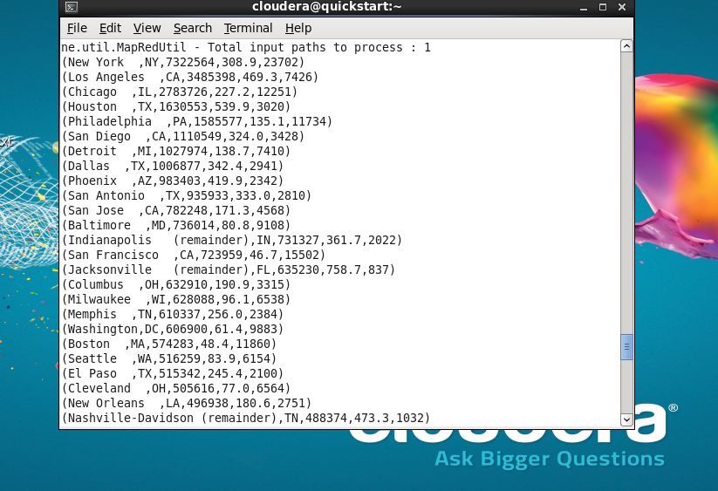
Best Places To Live In The United States
Results:-
1. Top cities based on lowest unemployment rates only

Slide 6
Best Places To Live In The United States
Results:-
Unemployment trends among cities from 2010 - 2014
Slide 5
Fall 2015
Fall 2015
6

Slide 7
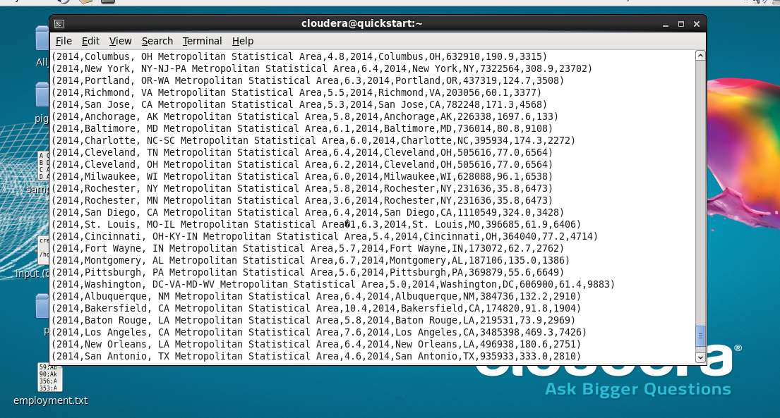
Best Places To Live In The United States
Results:-
2. Top cities based on unemployment rates as well as lowest crime rates (includes violent crimes and property crimes)
Slide 5
Fall 2015

Slide 8
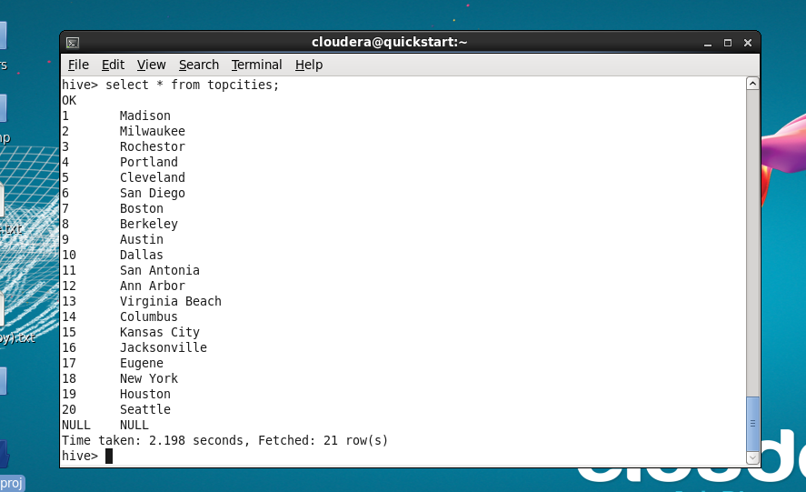
Best Places To Live In The United States
Results:-
3. Final results based on unemployment rates, crime rates as well as good air quality (clean cities)
Slide 5
Fall 2015

Slide 9
Best Places To Live In The United States
Results:-
Final results
Madison | Milwaukee | Rochester | Portland
Cleveland | San Diego | Boston | Berkeley
Austin | Dallas | San Antonio | Ann Arbor
Virginia Beach | Columbus | Kansas City | Jacksonville
Eugene | New York | Houston | Seattle
Slide 5
Fall 2015
Fall 2015
9

Slide 10
Best Places To Live In The United States
Obstacles
Prioritizing the criteria according to its impact on livability
Finding relevant datasets – Accurate air quality datasets proved to be the most difficult
Addressing data quality and data cleaning

Slide 11
Best Places To Live In The United States
Summary and Conclusion
We have compared our results with some of the surveys carried out by agencies like livability.com. More than ten of our top 20 results have been included in the popular surveys.
The criteria of livability varies across individuals. We have considered three basic deciding factors – economy, public safety and air quality. With more criteria involved the results can be more refined based on age-groups, occupation, etc.

Slide 12
Best Places To Live In The United States
Acknowledgement
We would like to thank Prof. McIntosh for providing us with this opportunity to work on this project and also guiding us throughout its progress. We would like to express our gratitude towards the TAs and past students of this course for their valuable advice. We would also like to acknowledge the vast and highly resourceful data provided by the federal government websites which have been the foundation stone of our project.
Slide 6
Fall 2015

Slide 13
Best Places To Live In The United States
References
T. White. Hadoop: The Definitive Guide. O’Reilly Media Inc., Sebastopol, CA, May 2012.
A. Gates. Programming Pig. O’Reilly Media Inc.,Sebastopol, CA, October 2011.
J. Dean and S. Ghemawat. MapReduce: Simplified data processing on large clusters. In proceedings of 6th Symposium on Operating Systems Design and Implemenation, 2004.
S. Ghemawat, H. Gobioff, S. T. Leung. The Google File System. In Proceedings of the nineteenth ACM Symposium on Operating Systems Principles – SOSP ‘03, 2003
Robert J. Rogerson. Quality of Life and City Competitiveness. Urban Studies, Vol. 36, Nos 5-6, 969-985, 1999
Erik Andersson. Urban Landscapes and Sustainable Cities. Ecology and society. 11:1, 34 [Journal article]
Thomas L. Saaty. Absolute and relative measurement with the AHP. The most livable cities in the United States. Socio-Economic Planning Sciences, Volume 20, Issue 6, 1986, Pages 327–331

Slide 14
Best Places To Live In The United States
Thank you!

